Slide 1
AZ-104T00A Administer Data Protection
Notes:
These Learn modules are part of the AZ-104: Monitor and back up Azure resources (https://docs.microsoft.com/learn/paths/az-104-monitor-backup-resources/learning path.

Slide 2


Administer Network Protection Introduction
Configure File and Folder Backups
Configure Virtual Machine Backups
Lab 10 – Implement Data Protection
Notes:
This content is part of the AZ-104: Monitor and back up Azure resources (https://docs.microsoft.com/learn/paths/az-104-monitor-backup-resources/) learning path.

Slide 3

Administer Data Protection whiteboard and review
What workloads can Azure Backup protect?
How would you configure file and folder backups?
Name at least two ways to protect virtual machine data.
Is there a way to recover virtual machine backups that have been deleted?
What is the difference between Azure Backup and Azure Site Recovery?
Backup Policies
Resilient backups (LRS, (RA-) GRS
Multiple access tiers (snapshots and vaults)
Built-in security (RBAC, encryption, soft-delete)
HTTPS, Secure Azure Networks (NSG and Firewall)
Azure storage (Files, Disks, and Blobs)
Virtual machines
SQL in Azure VM
On-premises servers
Azure Database for PostgreSQL servers
SAP Hana in Azure VM
Notes:
Optional whiteboard slide to introduce the module or review the content. Use the whiteboard diagram directly or recreate the image during the class.
What workloads can Azure Backup back up? Discuss both on-premises and Azure workloads.
Answer: Azure Backup is the main tool to backup and restore workloads. On-premises workloads include files and folders, Hyper-V virtual machines, VMware virtual machines, Microsoft SQL Server, Microsoft SharePoint, Microsoft Exchange, System State, and Bare Metal Recovery. Azure workloads include virtual machines, Azure file shares, SQL Server in Azure VM, and SAP HANA on an Azure VM.
You need to configure on-premises file and folder backups. What are basic steps to configuring the backup?
Answer: First, you will need to create a recovery service vault. Next, download the agent on the on-premises machine. The agent will need a credential certificate. Next, install and register the agent with Azure. Lastly, configure the backup policies. The portal provides a wizard to help with the agent steps.
Name at least two ways you can protect virtual machine data.
Answer: Virtual machine snapshots provide a quick and simple option for backing up VMs that use managed disks. Snapshots help capture information between formal backups. Azure Backup supports application-consistent backups for both Windows and Linux VMs. Azure Site Recovery protects your VMs from a major disaster scenario when a whole region experiences an outage.
Several of your virtual machine backups have been accidentally deleted. Is there any way to recover the deleted backups?
Answer: Soft delete has the capability to protect cloud backups for IaaS virtual machines from accidental as well as malicious deletion of backups. Soft delete provides 14 days of extended retention, allowing recovery with no data loss. Soft delete is offered at no cost and is natively built-in for all recovery service vaults. To recover the deleted backups, use the undelete feature.
What is the difference between Azure Backup and Azure Site recovery?
Answer: Azure Backup allows for granular backups and restores specific data. Azure Site Recovery (ASR) allows for the protection of an entire production site. ASR provides automation and orchestration to make the failover and failback processes seamless.

Slide 4
Configure File and Folder Backups

Slide 5
Configure File and Folder Backups Introduction
Describe Azure Backup Benefits
Implement Azure Backup Center
Setup Recovery Service Vault Backup Options
Demonstration – Backup Azure File Shares
Configure On-premises File and Folder Backups
Manage the Microsoft Azure Recovery Services Agent
Demonstration – Backup Files and Folders
Summary and Resources
Notes:
Monitor and maintain Azure resources (10–15%)
Implement backup and recovery
Create a Recovery Services vault
Create an Azure Backup vault
Create and configure a backup policy
Perform backup and restore operations by using Azure Backup
Configure and interpret reports and alerts for backups

Slide 6
Describe Azure Backup Benefits
Azure-based service used to back up and restore data in Microsoft cloud
Automatic Storage Management
Multiple storage options
Unlimited data transfer
Data encryption
Application consistent backup
Long-term retention
Notes:
Why use Azure Backup? - https://docs.microsoft.com/azure/backup/backup-introduction-to-azure-backup#why-use-azure-backup
✔️ What are some of the reasons your organization might choose Azure Backup?

Slide 7
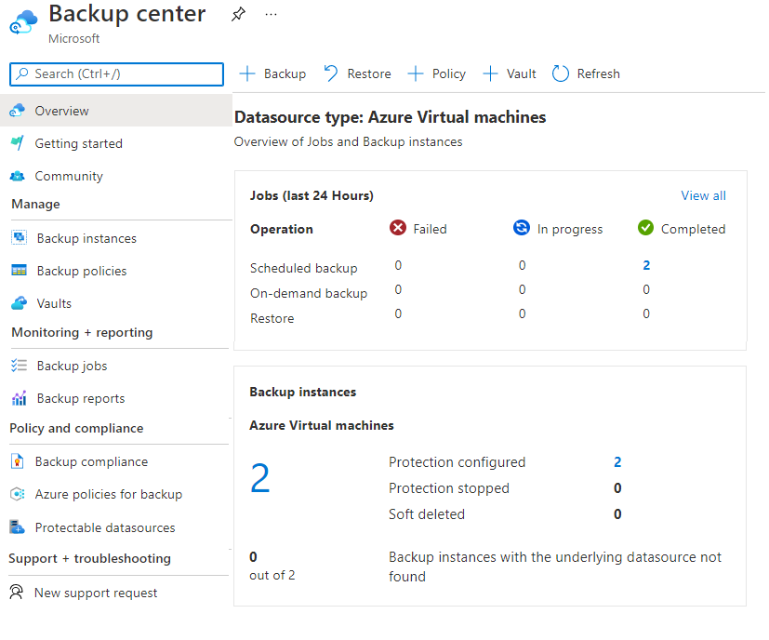
Implement Azure Backup Center
Single pane of glass to manage backups across a large and distributed Azure environment
Datasource-centric management focused on what you are backing up
Connected experiences with native integrations that enables management at scale
Notes:
Overview of Backup Center - https://docs.microsoft.com/azure/backup/backup-center-overview
Supported scenarios
Backup Center is currently supported for Azure VM backup, SQL in Azure VM backup, SAP HANA in Azure VM backup, Azure Files backup, Azure Blobs backup, Azure Managed Disks backup, and Azure Database for PostgreSQL Server backup.

Slide 8
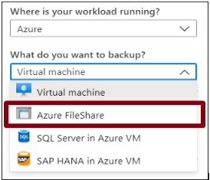
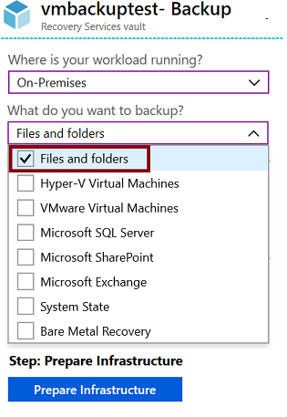
Setup Recovery Services Vault Backup Options - Files
Azure Workloads
On-Premises Workloads
Notes:
Recovery Services vaults overview - https://docs.microsoft.com/azure/backup/backup-azure-recovery-services-vault-overview
Create a Recovery Services vault - https://docs.microsoft.com/azure/backup/backup-create-rs-vault
Soft delete for virtual machines - https://docs.microsoft.com/azure/backup/soft-delete-virtual-machines

Slide 9
Demonstration – Backup Azure File Shares
Configure a storage account with file share
Create a Recovery Services vault
Configure file share backup
Verify the file share backup
Notes:
✔ Always consider having students walk-through the demonstrations themselves. Also, consider the overlap with the formal labs and your best use of time.

Slide 10
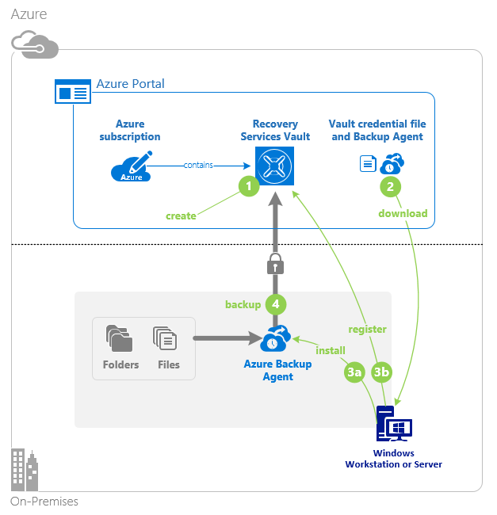
Configure On-Premises File and Folder Backup
Create the recovery services vault
Download the agent and credential file
Install and register agent
Configure the backup
Notes:
About Azure file share backup - https://docs.microsoft.com/azure/backup/azure-file-share-backup-overview
Back up Azure file shares - https://docs.microsoft.com/azure/backup/backup-afs

Slide 11
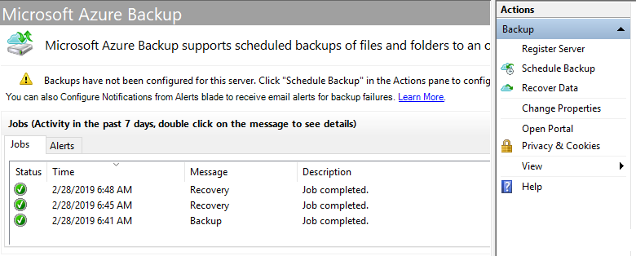
Manage the Microsoft Azure Recovery Services Agent
Backup or recover files and folders on physical or virtual Windows OS (VMs can be on-premises or in Azure)
No separate backup server required
Not application aware; file, folder, and volume-level restore only
No support for Linux
Notes:
Back up Windows Server files and folders to Azure -https://docs.microsoft.com/azure/backup/backup-windows-with-mars-agent

Slide 12
Demonstration – Backup Files and Folders
Create a Recovery Services vault
Configure the file backup
Notes:
Back up Azure file shares in the Azure portal - https://docs.microsoft.com/azure/backup/backup-afs

Slide 13
Summary and Resources – Configure File and Folder Backups
Knowledge Check Questions
Microsoft Learn Modules (docs.microsoft.com/Learn)
Introduction to Azure Backup
Notes:
Learn - https://docs.microsoft.com/learn/browse
The Assessment Guide in the MCT DLC includes open-ended questions.
What workloads can Azure Backup back up? Discuss both on-premises and Azure workloads.
Answer: Azure Backup is the main tool to backup and restore workloads. On-premises workloads include files and folders, Hyper-V virtual machines, VMware virtual machines, Microsoft SQL Server, Microsoft SharePoint, Microsoft Exchange, System State, and Bare Metal Recovery. Azure workloads include virtual machines, Azure file shares, SQL Server in Azure VM, and SAP HANA in Azure VM.
You need to configure on-premises file and folder backups. What are basic steps to configuring the backup?
Answer: First, you will need to create a recovery service vault. Next, download the agent on the on-premises machine. The agent will need a credential certificate. Next, install and register the agent with Azure. Lastly, configure the backup policies. The portal provides a wizard to help with the agent steps.

Slide 14
Configure Virtual Machine Backups

Slide 15
Configure Virtual Machine Backups Introduction
Protect Virtual Machine Data
​Create Virtual Machine Snapshots​
Setup Recovery Services Vault Backup Options
Backup Virtual Machines
Restore Virtual Machines
Demonstration – Virtual Machine Backups
Implement Azure Backup Server​
Compare Backup Options
Manage Soft Delete​
Implement Azure Site Recovery
Summary and Resources
Notes:
Monitor and maintain Azure resources (10–15%)
Implement backup and recovery
Create a Recovery Services vault
Create an Azure Backup vault
Create and configure a backup policy
Perform backup and restore operations by using Azure Backup
Configure Azure Site Recovery for Azure resources
Perform a failover to a secondary region by using Site Recovery
Configure and interpret reports and alerts for backups

Slide 16
Protect Virtual Machine Data
Snapshots
Azure backup
Azure Site Recovery
Managed snapshots provide a quick and simple option for backing up VMs that use Managed Disks
Azure Backup supports application-consistent backups for both Windows and Linux VMs
Azure Site Recovery protects your VMs from a major disaster scenario when a whole region experiences an outage
Notes:
An overview of Azure VM backup - https://docs.microsoft.com/azure/backup/backup-azure-vms-introduction
✔️ Have you tried any of these backup methods? Do you have a backup plan?

Slide 17
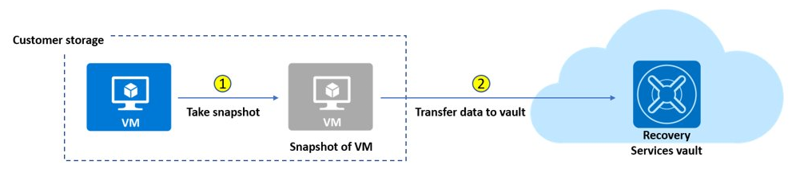
Create Virtual Machine Snapshots
Use snapshots taken as part of a backup job
Reduces recovery wait times – don’t wait for data transfer to the vault to finish
Configure Instant Restore retention (1 to 5 days)
Notes:
Create a snapshot - https://docs.microsoft.com/azure/virtual-machines/windows/snapshot-copy-managed-disk

Slide 18
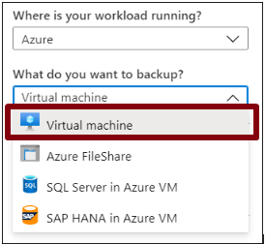
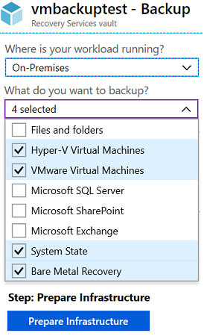

Setup Recovery Services Vault Backup Options - VMs
Azure Workloads
On-Premises Workloads
Multiple servers can be protected using the same Recovery Services vault

Slide 19
Backup Virtual Machines
Create a recovery services vault
Use the Portal to define the backup
Backup the virtual machine
1
2
3
Use a Recovery Services Vault in the region where you are performing your Virtual Machine backups and choose a replication strategy for Vault
Take snapshots (recovery points) of your data at defined intervals. These snapshots are stored in recovery services vaults
For the Backup extension to work, the Azure VM Agent must be installed on the Azure virtual machine
Notes:
Plan your VM backup infrastructure in Azure - https://docs.microsoft.com/azure/backup/backup-azure-vms-introduction
Tutorial: Back up and restore files for Windows virtual machines in Azure - https://docs.microsoft.com/azure/virtual-machines/windows/tutorial-backup-vms

Slide 20
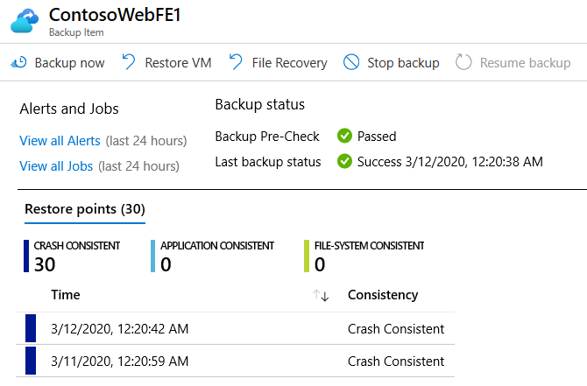
Restore Virtual Machines
Once you trigger the restore operation, the Backup service creates a job for tracking the restore operation
The Backup service also creates and temporarily displays notifications, so you monitor how the backup is proceeding

Slide 21
Demonstration – Virtual Machine Backups
Create a backup for virtual machines
Configure and review the backup policy
Notes:
Tutorial - Back up multiple Azure virtual machines - https://docs.microsoft.com/azure/backup/tutorial-backup-vm-at-scale

Slide 22

Implement Azure Backup Server
Azure
Specialized Workloads
Virtual Machines
Files/Folders/Volumes
System Center DPM
Or Azure Backup Server
App-aware backups, file/folder/volume backups, and machine state backups (bare-metal, system state)
Each machine runs the DPM/MABS protection agent, and the MARS agent runs on the MABS/DPM
Flexibility and granular scheduling options
Manage backups for multiple machines in a protection group

Slide 23
Compare Backup Options
Component | Benefits | Limits | Protects | Backup Storage
Azure Backup (MARS) agent | Backup files and folders on physical or virtual Windows OS No separate backup server required | Backup 3x per day Not application aware File, folder, and volume-level restore only No support for Linux | Files Folders | Recovery services vault
Azure Backup Server (MABS) | App aware snapshots Full flex for when to backups Recovery granularity Linux support on Hyper-V and VMware VMs Backup and restore VMware VMs Doesn’t require a System Center license | Cannot backup Oracle workloads Always requires live Azure subscription No support for tape backup | Files Folders Volumes VMs Applications Workloads | Recovery services vault Locally attached disk

Slide 24
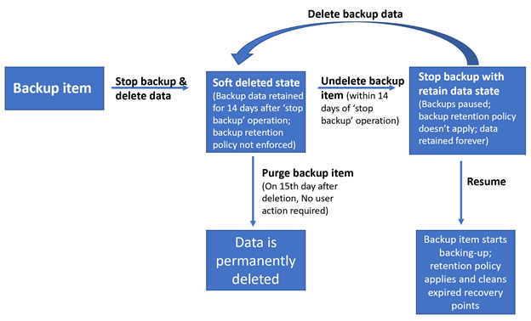
Manage Soft Delete
Backup data is retained for 14 additional days*
Recover soft deleted backup items using an ‘Undelete’ operation
Also available for storage account containers and file shares
Natively built-in for all the recovery services vaults
Notes:
Soft delete for virtual machines in Azure Backup - https://azure.microsoft.com/updates/soft-delete-virtual-machine-backup/
* Now soft delete number of days can be extended beyond 14 days, although it will have a fee associated to it.

Slide 25
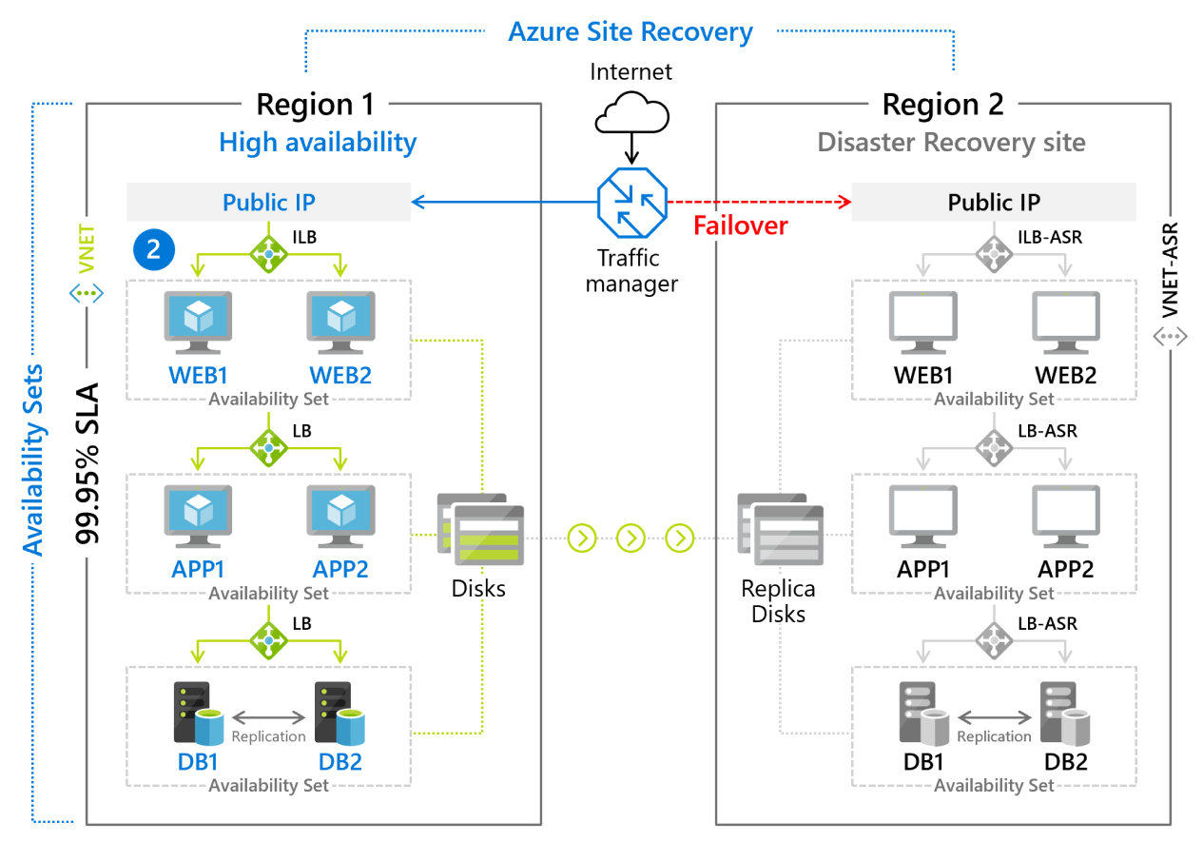
Implement Azure Site Recovery
Replicate Azure VMs from one Azure region to another
Replicate on-premises VMware VMs, Hyper-V VMs, physical servers (Windows and Linux), Azure Stack VMs to Azure
Replicate AWS Windows instances to Azure
Replicate on-premises VMware VMs, Hyper-V VMs managed by System Center VMM, and physical servers to a secondary site
Notes:
Azure Site Recovery documentation - https://docs.microsoft.com/azure/site-recovery/
Concentrate on replication within Azure and not migration scenarios from on-premises.
Note: Physical servers replicated to Azure using Site Recovery can only fail back as VMware VMs. You need a VMware infrastructure in order to fail back. https://docs.microsoft.com/azure/site-recovery/physical-to-azure-failover-failback#prepare-for-reprotection-and-failback

Slide 26
Summary and Resources – Configure Virtual Machine Backups
Knowledge Check Questions
Microsoft Learn Modules (docs.microsoft.com/Learn)
Introduction to Azure Backup
Protect your virtual machines by using Azure Backup
Implement hybrid backup and recovery with Windows Server IaaS
Protect your Azure infrastructure with Azure Site Recovery
Notes:
Learn - https://docs.microsoft.com/learn/browse
The Assessment Guide in the MCT DLC includes open-ended questions.
Name at least two ways you can protect virtual machine data.
Answer: Virtual machine snapshots provide a quick and simple option for backing up VMs that use managed disks. Snapshots help capture information between formal backups. Azure Backup supports application-consistent backups for both Windows and Linux VMs. Azure Site Recovery protects your VMs from a major disaster scenario when a whole region experiences an outage.
Several of your virtual machine backups have been accidentally deleted. Is there are any way to recover the deleted backups?
Answer: Soft delete has the capability to protect cloud backups for IaaS virtual machines from accidental as well as malicious deletion of backups. Soft delete provides 14 days of extended retention, allowing recovery with no data loss. Soft delete is offered at no cost and is natively built-in for all recovery service vaults. To recover the deleted backups, use the undelete feature.
What is the difference between Azure Backup and Azure Site recovery?
Answer: Azure Backup allows for granular backups and restores specific data. Azure Site Recovery (ASR) allows for the protection of an entire production site. ASR provides automation and orchestration to make the failover and failback processes seamless.

Slide 27
Lab 10 – Implement Data Protection

Slide 28
Lab 10 – Backup virtual machines
Lab scenario
You have been tasked with evaluating the use of Azure Recovery Services for backup and restore of files hosted on Azure virtual machines and on-premises computers. In addition, you want to identify methods of protecting data stored in the Recovery Services vault from accidental or malicious data loss
Objectives
Task 1: Provision the lab environment
Task 2: Create a Recovery Services vault
Task 3: Implement Azure virtual machine-level backup
Task 4: Implement File and Folder backup
Task 5: Perform file recovery by using Azure Recovery Services agent
Task 6: Perform file recovery by using Azure virtual machine snapshots
Task 7: Review the Azure Recovery Services soft delete functionality
Next slide for an architecture diagram
Notes:
LAB 10 - Implement Data Protection - ESTIMATED DURATION 50 MIN
Lab Repository - https://microsoftlearning.github.io/AZ-104-MicrosoftAzureAdministrator/

Slide 29





Lab 10 – Architecture diagram
Task 1
Task 2
az104-10-rg0
az104-10-rg1
az104-10-vnet 10.0.0.0/24
Task 7
Subnet0 10.0.0.0/26
az104-10-rsv1
Task 3: Backup VM
Task 6: Recover File
az104-10-vm0
10.0.0.4
az104-10-vm0 Backup
Task 4: Backup File
Task 5: Recover File
az104-10-vm1
10.0.0.5
File Backup from az104-10-vm1
C:\Windows\System32\drivers\etc\hosts

Slide 30

End of presentation

